Slide 1
Classical Ml
Machine Learning is an Application of Artificial Intelligence (AI) it gives devices the ability to learn from their experiences and improve their self without doing any coding. For Example, when you shop from any website it’s shows related search like:- People who bought also saw this.
Machine Learning is defined as “Field of study that gives computers the capability to learn without being explicitly programmed”.

Slide 2
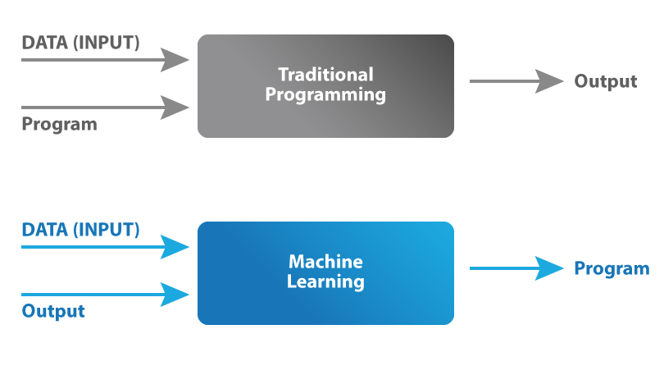

Slide 3
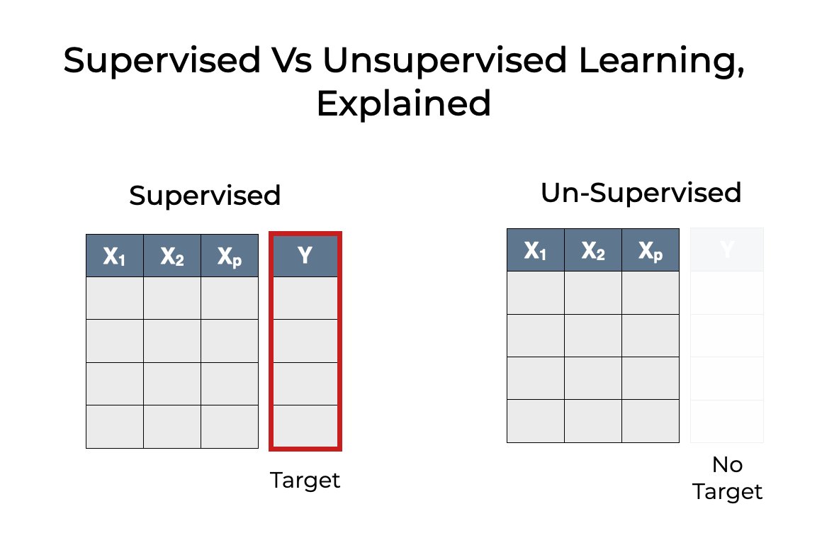
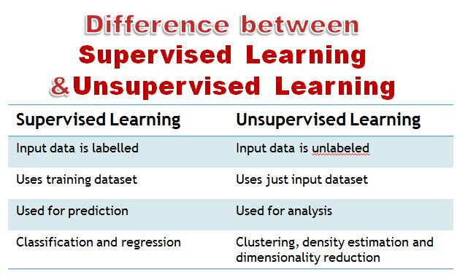
Supervised and Unsupervised Learning

Slide 4
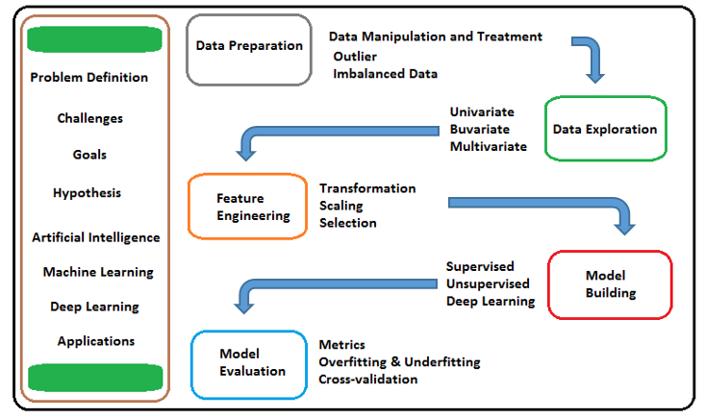
ML Pipeline

Slide 5
Preprocessing
Before we start with data we need to a data to work upon . When creating a machine learning project, it is not always a case that we come across the clean and formatted data. And while doing any operation with data, it is mandatory to clean it and put in a formatted way. So for this, we use data preprocessing task.
Getting the dataset
Importing libraries
Importing datasets
Finding Missing Data
Encoding Categorical Data
Splitting dataset into training and test set
Feature extraction

Slide 6
Getting the Data
There are mainly two ways to load data depending on the method
CSV data
Pre defined data like mnist , breast dataset
Using deep learning models like image generator , img to array etc
Using np.load for npz files (NPZ is a file format by numpy which allows storage of data in the form of np array using gfile compression

Slide 7
Importing Libraries
We use various libraries to perform various functions and hence we need to import them
Import numpy as np
From tensorflow import keras
From tensorflow.preprocessing.image import ImageDataGenerator , array_to_img

Slide 8
Handling Missing Data
The next step of data preprocessing is to handle missing data in the datasets. If our dataset contains some missing data, then it may create a huge problem for our machine learning model. Hence it is necessary to handle missing values present in the dataset.
Ways to handle missing data:
There are mainly two ways to handle missing data, which are
Deleting the missing row
Replacing the missing data with mean
We mainly use scikit-learn to replace data

Slide 9
Missing data ( continued )
Deleting the values from the dataset which contains null values result in reduced dataset and information loss
Therefore we mainly use replacing values with mean using an imputer from scikit-learn
Here we prefer using median over mean due to outlier i.e . Extreme values which distorts the mean values and hence the dataset which further affects the training of the models resulting in false weights

Slide 10
Encoding Categorical Data
Categorical data is data which has some categories such as, in our dataset; there are two categorical variable, Country, and Purchased.
Since machine learning model completely works on mathematics and numbers, but if our dataset would have a categorical variable, then it may create trouble while building the model. So it is necessary to encode these categorical variables into numbers.
we can imported LabelEncoder class of sklearn library. This class has successfully encoded the variables into digits.

Slide 11
LabelEncoder vs oneHotEncoder
But in our case, there are three country variables, and as we can see in the above output, these variables are encoded into 0, 1, and 2. By these values, the machine learning model may assume that there is some correlation between these variables which will produce the wrong output. So to remove this issue, we will use dummy encoding.
Dummy variables are those variables which have values 0 or 1. The 1 value gives the presence of that variable in a particular column, and rest variables become 0. With dummy encoding, we will have a number of columns equal to the number of categories.
In our dataset, we have 3 categories so it will produce three columns having 0 and 1 values. For Dummy Encoding, we will use OneHotEncoder class of preprocessing library

Slide 12
Splitting the dataset
In machine learning data preprocessing, we divide our dataset into a training set and test set. This is one of the crucial steps of data preprocessing as by doing this, we can enhance the performance of our machine learning model.
Suppose, if we have given training to our machine learning model by a dataset and we test it by a completely different dataset. Then, it will create difficulties for our model to understand the correlations between the models.
If we train our model very well and its training accuracy is also very high, but we provide a new dataset to it, then it will decrease the performance. So we always try to make a machine learning model which performs well with the training set and also with the test dataset. Here, we can define these datasets as:

Slide 13
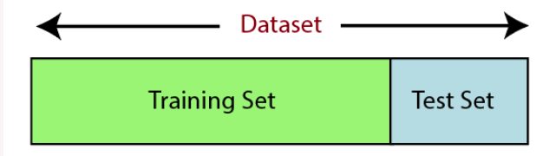
Training Set: A subset of dataset to train the machine learning model, and we already know the output.
Test set: A subset of dataset to test the machine learning model, and by using the test set, model predicts the output.
In the second line, we have used four variables for our output that are
x_train: features for the training data
x_test: features for testing data
y_train: Dependent variables for training data
y_test: Independent variable for testing data
In train_test_split() function, we have passed four parameters in which first two are for arrays of data, and test_size is for specifying the size of the test set. The test_size maybe .5, .3, or .2, which tells the dividing ratio of training and testing sets.
The last parameter random_state is used to set a seed for a random generator so that you always get the same result, and the most used value for this is 42.

Slide 14
Feature Scaling
Feature scaling is the final step of data preprocessing in machine learning. It is a technique to standardize the independent variables of the dataset in a specific range. In feature scaling, we put our variables in the same range and in the same scale so that no any variable dominate the other variable.
As we can see, the age and salary column values are not on the same scale. A machine learning model is based on Euclidean distance, and if we do not scale the variable, then it will cause some issue in our machine learning model.

Slide 15
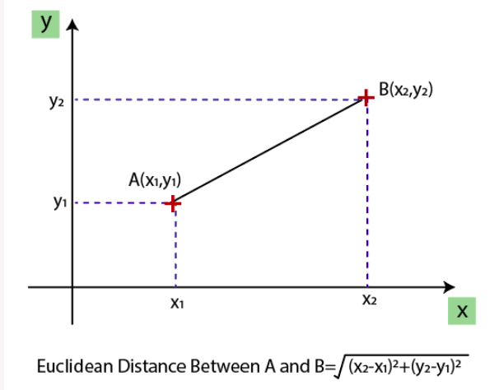
Euclidean distance

Slide 16
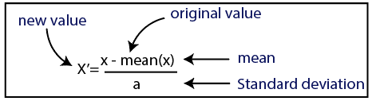
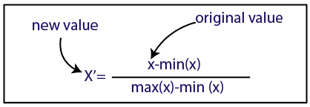
If we compute any two values from age and salary, then salary values will dominate the age values, and it will produce an incorrect result. So to remove this issue, we need to perform feature scaling for machine learning.
There are two ways to perform feature scaling in machine learning:
Standardization Normalization

Slide 17
Standardization
Standardization is another scaling technique where the values are centered around the mean with a unit standard deviation. This means that the mean of the attribute becomes zero and the resultant distribution has a unit standard deviation.
Here, we will use the standardization method for our dataset.
For feature scaling, we will import StandardScaler class of sklearn.preprocessing library
Now, we will create the object of StandardScaler class for independent variables or features. And then we will fit and transform the training dataset.
For test dataset, we will directly apply transform() function instead of fit_transform() because it is already done in training set.

Slide 18

Normalization
Normalization is a scaling technique in which values are shifted and rescaled so that they end up ranging between 0 and 1. It is also known as Min-Max scaling.
Here, Xmax and Xmin are the maximum and the minimum values of the feature respectively.
When the value of X is the minimum value in the column, the numerator will be 0, and hence X’ is 0
On the other hand, when the value of X is the maximum value in the column, the numerator is equal to the denominator and thus the value of X’ is 1
If the value of X is between the minimum and the maximum value, then the value of X’ is between 0 and 1

